Slide 1
SDC Deep Dive and SDK
By Michael Lando
2017-12-04

Slide 2
Agenda
The session will cover:
How SDC stores information using Graph DB
SDC distribution client SDK
SDC Tosca Parser SDK

Slide 3
SDC Intro
SDC is the Design platform for ONAP.
You can define SDC as the IDE for designating VF’s and SERVIES.
SDC provides an extensive visual interface for modeling.
Using SDC you can change different parts of the model including instances, properties, relationships and more.
SDC also provides an interface for distributing the modeled services to the run time components.

Slide 4
How SDC Onboards VNF’s
SDC receives a VNF package, this package can be HEAT based or Tosca based.
SDC needs to store the information in its internal DB.
The approach SDC took for this is to model its entities as vertexes and links on a directed graph.
All the Tosca information provided to SDC is separated into the different entities and stored as vertexes on a graph, the relationships between the different entities, and other logical connections are stored as links.

Slide 5
SDC Graph DB
SDC uses Titan Graph DB to create the graph DB Abstraction.
https://github.com/thinkaurelius/titan
SDC plans to transition to JenusGraph in the Future because Titan is no longer actively supported.
We use Titan as a client on the server side.
The persistency is provided by Cassandra server.

Slide 6
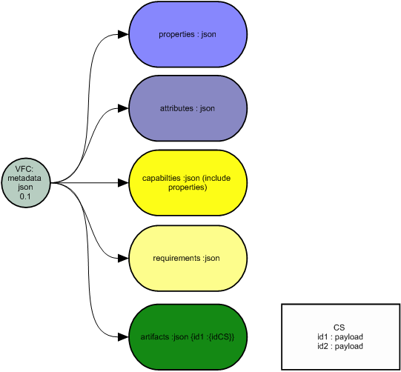
Simple Representation (VFC, CP, VL)
When importing node types in
to the SDC, they are represented
in the following manner:

Slide 7
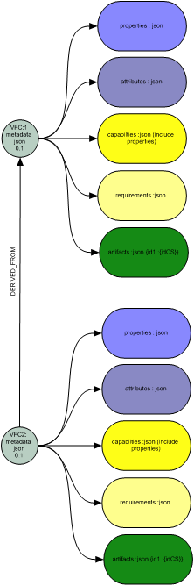
Resource hierarchy (VFC, CP, VL)
Data will be cloned
from derived and merged
with data from new resource.

Slide 8
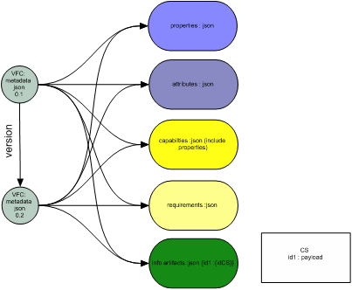
Check out (VFC, CP, VL)
Clone operations (check out and certify)
will be shallow copy.
Only metadata vertex will be cloned.
In case of update any part of component,
only relevant block will be copied.

Slide 9
Update (VFC, CP, VL)
When updating a section.
It will be cloned and a new link will be
generated.

Slide 10
SDC
More information:
SDC Portal
Gerrit repo
https://gerrit.onap.org/r/gitweb?p=sdc.git;a=summary

Slide 11
Questions
Q&A

Slide 12
SDC Distribution
SDC communicates with run time components using DMaaP.
Once a service is certified, a user can choose to distribute the service.
On distribution SDC sends a notification to a predefined topic.
All components can subscribe to this topic to receive notifications once they are send.

Slide 13
SDC Distribution Client
In order to simplify the work that is needed to receive notifications,
SDC provides the distribution client SDK.
The SDK allows an easy interface for handling the communication with the DMaaP.
The client allows:
Register for Distribution
Get Distribution Notification
Send Distribution Status
Get (download) Deployment Artifact
Unregister from Distribution
Currently the distribution client is used by: A&AI,SDNC,SO,DCAE and APPC.

Slide 14
SDC Distribution Client
At the Currently SDC distributes the following artifact as part of service distribution:
HEAT, HEAT_VOL,HEAT_NET, HEAT_ENV, HEAT_NESTED, HEAT_ARTIFACT,
MURANO_PKG,
YANG_XML,
OTHER,
VF_LICENSE, VENDOR_LICENSE,
MODEL_INVENTORY_PROFILE, MODEL_QUERY_SPEC,
APPC_CONFIG,
VNF_CATALOG,
VF_MODULES_METADATA,
DCAE_TOSCA, DCAE_JSON, DCAE_POLICY, DCAE_DOC,
DCAE_EVENT, DCAE_INVENTORY_TOSCA, DCAE_INVENTORY_JSON,
DCAE_INVENTORY_POLICY, DCAE_INVENTORY_DOC,
DCAE_INVENTORY_BLUEPRINT, DCAE_INVENTORY_EVENT;
More information can be found here. supported artifact types

Slide 15
SDC Distribution Client
SDC uses Pub-Sub technology to notify about distributed service versions.
Each ONAP Distribution consumer has to be registered as a consumer of Distribution Notification events and as a producer for Distribution Status events.
Once a new service version is approved for distribution, SDC publishes it with the information about the deployment service artifacts including their name , type , relative URL for download and checksum to validate the artifact’s payload data integrity when downloaded. Distribution notification is sent only for one specific service version.
ONAP component has to identify the artifacts to download ( based on the “artifact type” details)
SDC exposes An external API to download needed artifacts.
Once a service artifact is downloaded /deployed, ONAP Distribution consumer has to publish the distribution status event and SDC has to consume it and store it for the further distribution status analysis and monitoring.

Slide 16
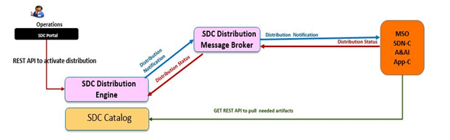
SDC Distribution Client

Slide 17
SDC Distribution Client
More information can be found here:
Full AID:
https://wiki.onap.org/display/DW/SDC+Distribution+client+AID
Gerrit repository:
https://gerrit.onap.org/r/gitweb?p=sdc/sdc-distribution-client.git;a=summary
JavaDocs:
https://nexus.onap.org/content/sites/site/org/openecomp/sdc/sdc-distribution-client/1.2.2/staging/

Slide 18
Questions
Q&A

Slide 19
SDC Tosca Parser
SDC uses Tosca templates and the Tosca spec-defined CSAR package to distribute the definition of new services.
Prior to creating SDC Tosca Parser, there was no standard way for parsing the CSAR.
Each component that received the CSAR, created its own logic for parsing it.
In order to create a standard and make the CSAR parsing easier.
SDC created a Tosca parser.
The team checked different alternatives, but no other Tosca-compliant Java-based parser was found.

Slide 20
SDC Tosca parser
The solution chosen by SDC was to port the OpenStack Tosca parser into java.
SDC created a generic Java-based parser - JTosca.
In order to make the parsing easier for the components, SDC created a wrapper over the JTosca - SDC-Tosca.
The abstraction allows the user to use the definitions used by SDC over the CSAR.
The SDC Parser is the recommended way for reading the CSAR generated by SDC, SDC validates the CSAR’s generated using the parser and works to align any changes done across the SDC and the Parser.
SDC Tosca is distributed as a standalone JAR that can be integrated into any project.
Currently the SDC Tosca parser is used by SO, SDNC, VID and more.

Slide 21
SDC Tosca Parser Use
In order to initiate the SDC TOSCA Parser with the downloaded service CSAR, an instance of ISdcCsarHelper has to be created,
initiated with the downloaded CSAR.
The CSAR file should be persisted on disk.
See sample code:
Once the factory method is called the sdc parser will parser the CSAR and create the needed objects for its functionality.
The SDC parser is aligned with the SDC conformance level.
SDC marks any change in the model by increasing conformance level.
SdcToscaParserFactory factory = SdcToscaParserFactory.getInstance();
ISdcCsarHelper helper = factory.getSdcCsarHelper(file.getAbsolutePath());

Slide 22
SDC Tosca Parser Notifications
SDC parser error notifications.
As part of the parsing process we expose all the issues Identified.
The issues are classified according to there severity:
Not analyzed represents issues that are currently not categorized by the parser.
Currently, all categorized items are classified as warnings.
No item is currently classified as critical, that is trying to terminate the parser flow by throwing an exception. in future releases we plan to add the ability to classify items as critical’s in the parser configuration.
The SDC parser will try to parse all the whole CSAR and collect all available issues.
List<JToscaValidationIssue> notAnalyzedReport = factory.getNotAnalyzadExceptions();
List<JToscaValidationIssue> warningsReport = factory.getWarningExceptions();
List<JToscaValidationIssue> criticalsReport = factory.getCriticalExceptions();

Slide 23
SDC Tosca parser
SDC Tosca parser
Gerrit repo:
https://gerrit.onap.org/r/gitweb?p=sdc/sdc-tosca.git;a=summary
JavaDocs:
https://nexus.onap.org/content/sites/site/org/openecomp/sdc/sdc-tosca/1.2.0/staging/

Slide 24
Questions
Q&A

Slide 25
Thank you !

